Slide 1


Hobby Web Application
Hobby Web Application
Usman Sajid
Usman Sajid

Slide 2
Introduction
The idea:
To create a CRUD based website application that allows user to create a custom Anime Watch List
The idea:
To create a CRUD based website application that allows user to create a custom Anime Watch List

Slide 3
The Approach
Project specification requirements
Documentation
Note taking and breaking things down into user stories
Project Management Tools- JIRA
Design Front End; HTML, CSS, JS
Back End; Spring and Database
Testing
Testing

Slide 4
Consultancy Journey
Version Control System: Git
Source Code Management: GitHub
Kanban Board: Jira (Scrum Board)
Database Management System: MySQL Server 5.7 (local or GCP instance)
Back-End Programming Language: Java
API Development Platform: Spring
Front-End Web Technologies: HTML, CSS, JavaScript
Build Tool: Maven
Static Analysis: SonarQube
Unit Testing: JUnit, Mockito
User-Acceptance Testing: Selenium

Slide 5
Project Architecture

Slide 6
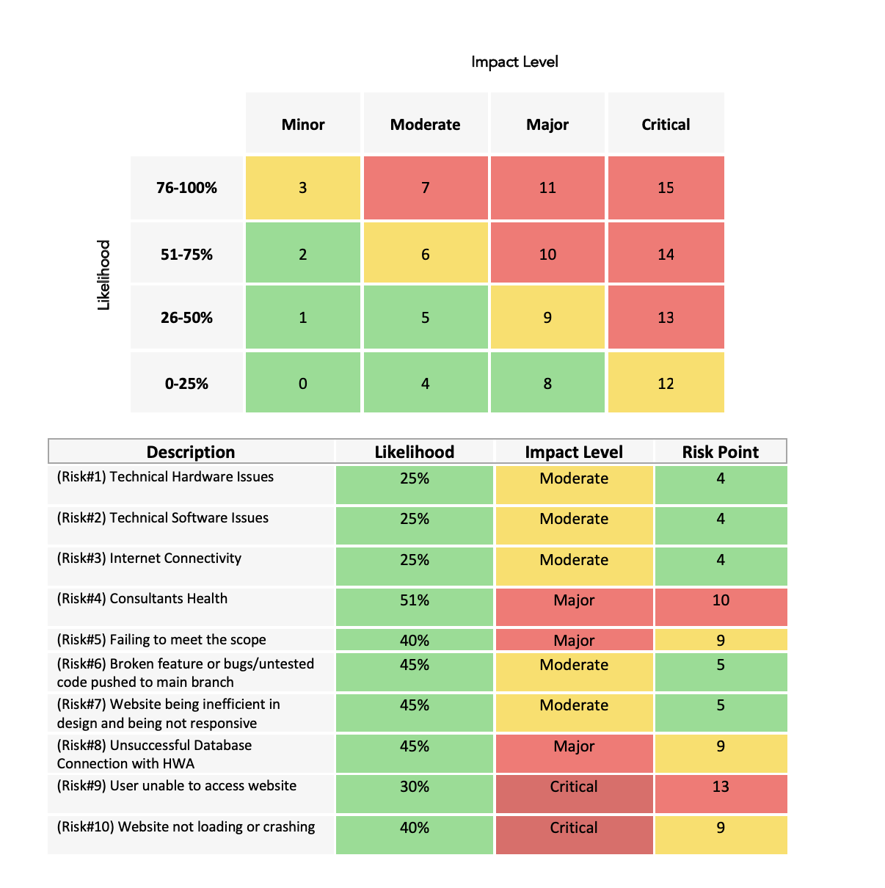
Risk Assessment

Slide 7
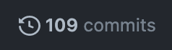
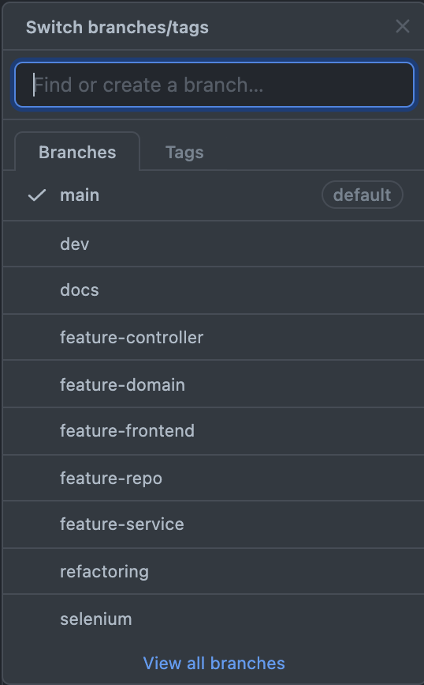
CI Version Control
No starter point
Followed correct branching procedures
Merged each changed to dev
Upon completion, sent Pull Req before merging to main
10 branches 109 commits

Slide 8
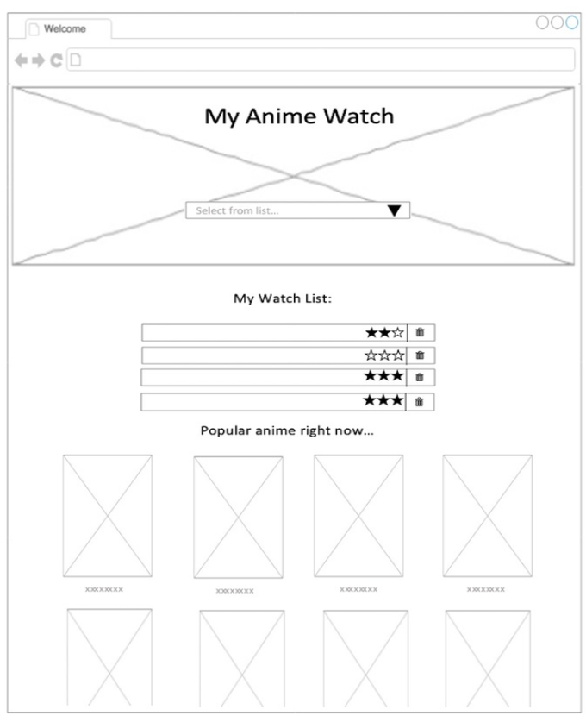
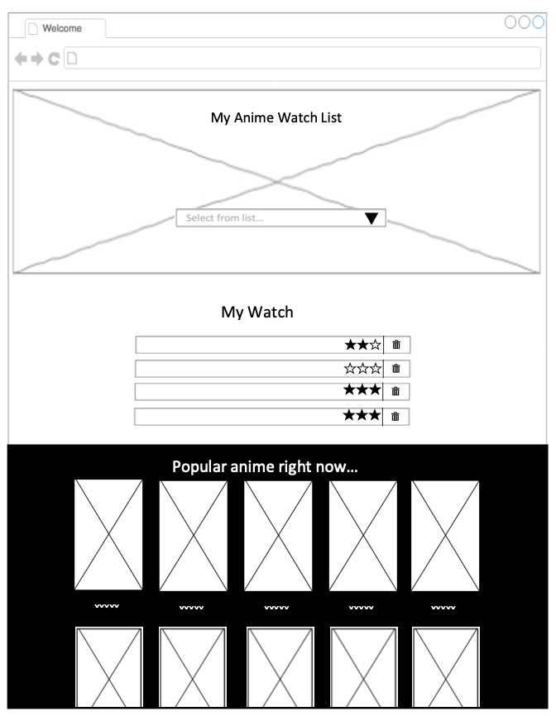
Mock Designs, ERD & UML

Slide 9
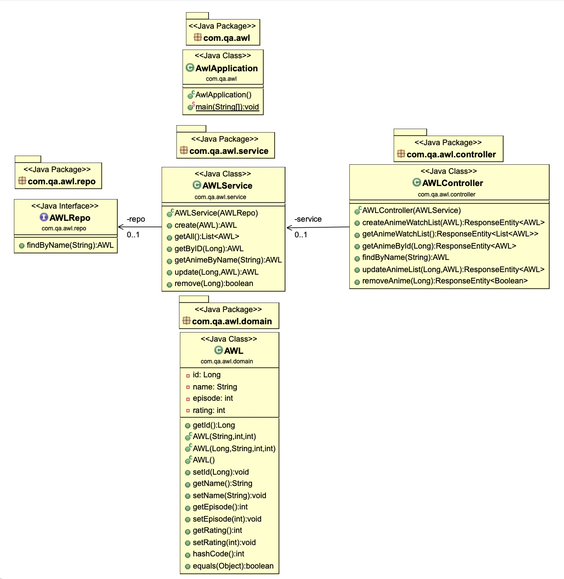
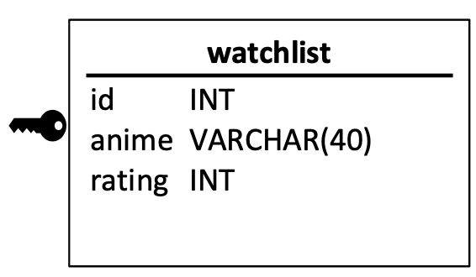
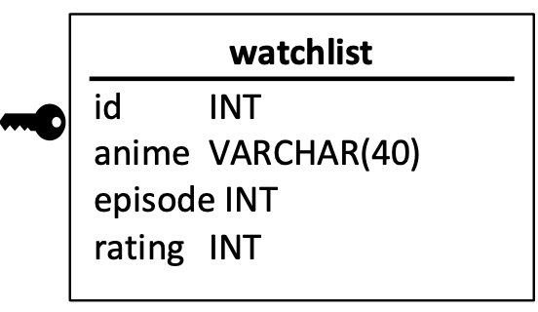
Mock Designs, ERD & UML
UML:
Initial
Final
Notes:
Next with regards to actual back design aspects,
With this project the minimum recommended requirement was just one table as there was no DTO, and I hence I kept to this to keep it simple and to ensure I complete everything on time.
From this you can see the ERD and that it was more or less the same- the only difference being I decided as I was working on the back end to also have an episode counter for the user so that was another thing I added.
Since there was only one table I didn’t have to worry much about relationships or anything like that.
and as you can see as well here is the UML diagram which set to provide a way to visualize the design structure of the backend code.

Slide 10
Demonstration

Slide 11
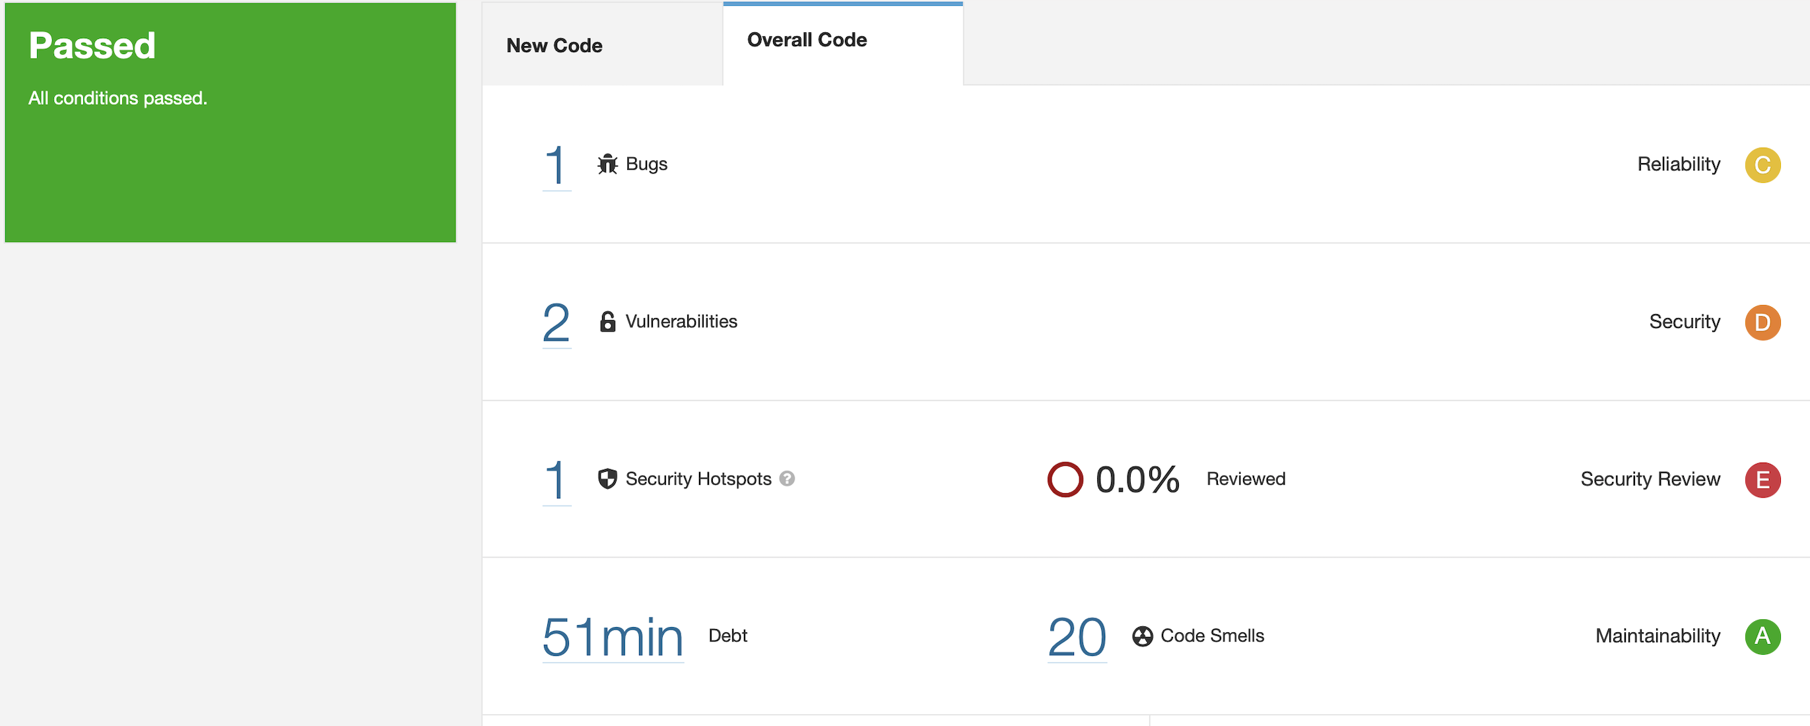


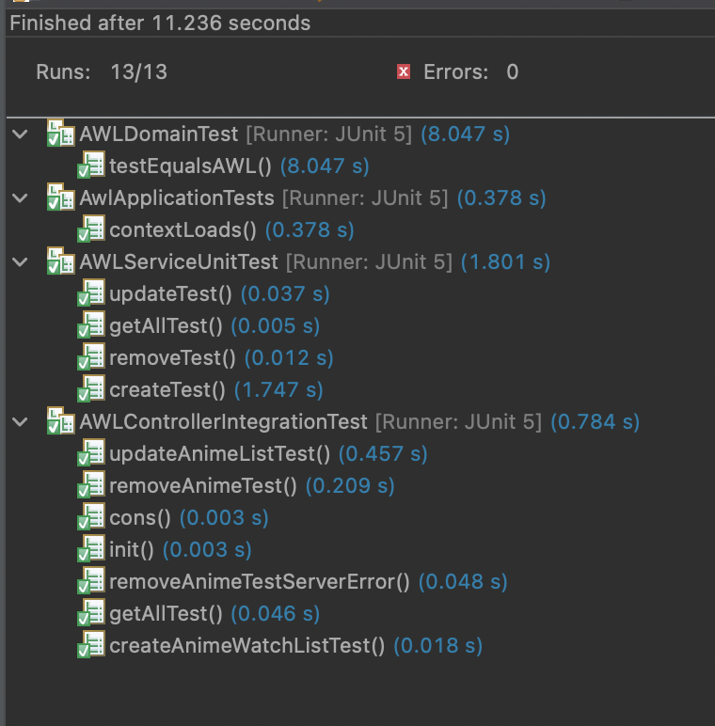
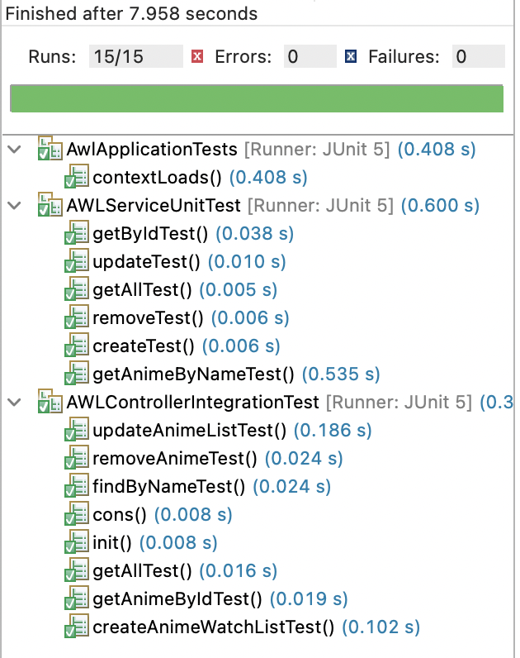
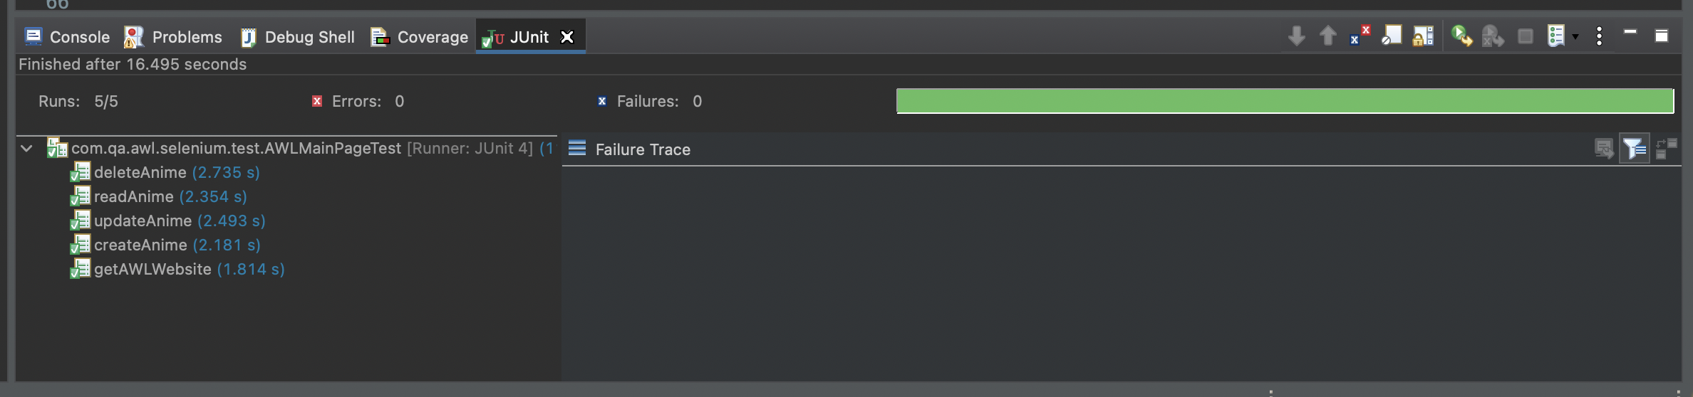

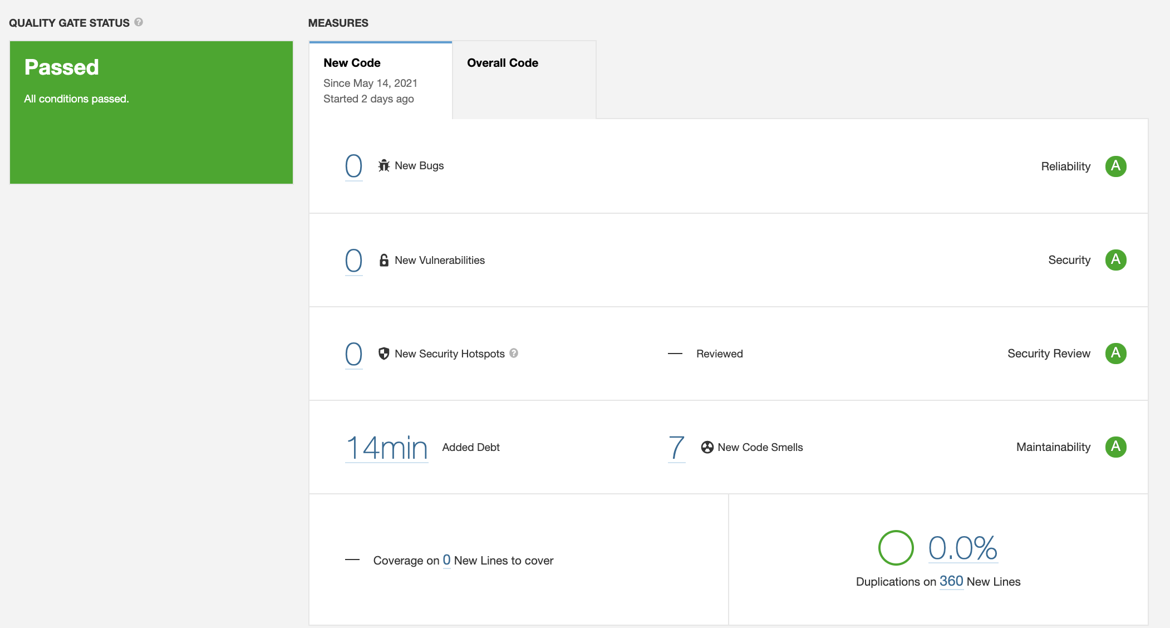
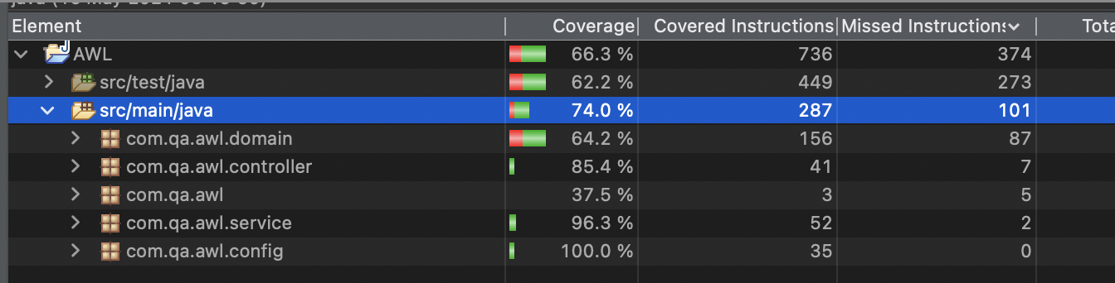
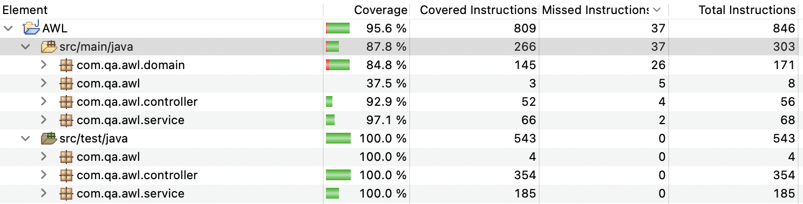
Testing
B/e:
Was: 87% Coverage – Dropped to 74%
Integration Testing ~ Controller
Unit Testing ~ Service
F/e:
Tested CRUD to ensure the website functions correctly

Slide 12
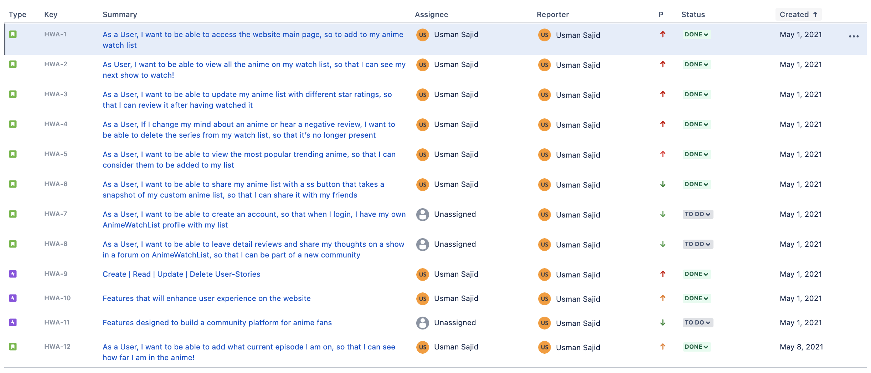
Sprint REVIEW
Completed:
Epic 1-7: ✓
Product Backlog:
Epic 8-9 (Wont-have)

Slide 13
Sprint RETROSPECTIVE
+ Good use of commits and commits messages
+ Better planning
+ Wider User of User Stories AND Acceptance Criteria’s
+ Merged to main via Pull Request
> Easily able to refer back to previous commits, when had problems with current one
> Allowed me to tackle the project in a a more streamline way
> Include user stories for additional features and have greater fulfilment understanding with use of acceptance criteria’s
- Focus more on the project MVP before tackling additional features

Slide 14
Conclusion
~Final thoughts….
Really enjoyed this project
Valuable experience
Newfound passion for front end design
~Future Steps…
Practice more Coding!
Revisit Testing and Selenium
[HWA Application considerations]
User Login Page, More Community features such as Forum and a share button

Slide 15
Questions?

